Slide 1
Recommending a location for a new it company office in paris
Applied Data Science Capstone
IBM Data Science Professional Certificate
November 2018
Performed by MRABAH Yassine

Slide 2

Contents:
1- Introduction to the problem
2- Data scraping
3- Used methodology
4- Results
5- Conclusions

Slide 3
1- Introduction to the problem
The challenge: A well-known IT company thinks about founding a new office at the heart of Paris, because most of its employees live in the suburbs of Paris, and taking the common transport from the suburbs to the center of Paris is easier than moving from Paris to the suburbs or from a suburb to another suburb. The company needs to take in consideration many important factors:
1- Companies inside Paris don’t have internal restaurants, so employees usually go to nearby restaurants & spots for lunch.
2- The company noticed from its experience that employees in other offices located outside of city centers practice running or other different kinds of sports around the hills and forests near the office after lunch break
3- The new office in Paris needs to be easily accessed by everybody to avoid wasting time moving to or from it.
4- The company needs to acquire a new office, so it should make a good investment, because it will buy a new office and it should take into consideration the price of a squared meter which isn’t that cheap in Paris.
The company needs to make a good investigation and a well structured study to make the right choice concerning the location of this office. This study will be based on the accessibility and availability of restaurants, the accessibility to metro and train stations, the accessibility to sport centers and public parks and finally and most importantly he price of a squared meter.
Paris has 20 arrondissements or neighborhoods, and they are called like that: 1st arrondissement, 2nd arrondissement until 20th arrondissement.
Which arrondissement is the most suitable for a new office to this company ?

Slide 4
1- Introduction to the problem
My employees requirements
My requirements
Accessibility to metro stations
I am an IT company, I need to establish a new office at the heart of Paris !
I need to make a logical investment, The price of a m² is expensive, so which neighborhood in Paris should I choose ?
Accessibility to various restaurants & spots
Accessibility to public parks and sport centers
My employees should be satisfied by the new office

Slide 5
2- Data scraping
Opendata.paris.fr
A real estate agency
The foursquare API
Stations data & locations
The price of a m² in each arrondissement in Paris
Coordinates of Paris
Restaurants locations
Public parks, sport centers locations
We’re going to collect data from these different sources, and then we will create a new data frame where we will combine the most important “columns” extracted from each source

Slide 6
3- Used methodology
The first step after making all the needed data available and finishing the preprocessing part, we need to calculate the settlement index, which is an index that varies from 1 to 10. A good neighborhood (in Paris they call it arrondissement) is the one that have the highest index, and the highest index is the closest one to 10, and the lowest one is the closest one to 1.
The 5 main features extracted from the various data sources are, and each feature is going to be given a weight, based on the importance given by the company for the selection:
We used the MaxMin scaler from sklearn to normalize the values:
normalized value = (value – minValue) / (maxValue – minValue)
The weights, multiplied by each deature and then summed together will give is the index, which is a value between 1 and 10, the value is going to be equal to 10 for a most perfect situation:
Number of restaurants nearby ➔ Normalization ➔ multiply it by the weight (= 2)
Number of public parks nearby ➔ Normalization ➔ multiply it by the weight (= 1)
Number of sport centers nearby ➔ Normalization ➔ multiply it by the weight (= 1)
Number of metro and train stations nearby ➔ Normalization ➔ multiply it by the weight (= 2)
The price of the m² in the neighborhood ➔ Normalization ➔ multiply it by the weight (= 4)
As we can see, the sum of the weights = 10
Settlement index = Normalized val restauranst x 2 + Normalized val Nb stations x 2 + Normalized val Nb parks x 1 + Normalized val Nb sport centers x 1 + Normalized val price m² x 4

Slide 7
3- Used methodology
2
Weights
We define the settlement index (a value between 1 and 10), we will select the neighborhood that has a value closer to 10
M² price affordability
4
1
Accessibility to public transport
Data from multiple sources as described in the previous chapter
2
3
Accessibility to various restaurants
Visualization of the results on a map
2
Comparison
Accessibility to public parks
1
Perform clustering analysis to find similar neighborhoods without calculating the settlement index
Accessibility to sport centers
1
We will compare the obtained values to a clustering analysis where we will cluster neighborhoods based on their similarities ➔ This process will ensure us and make the results obtained from the settlement index calculations more reliable
Sum = 10

Slide 8
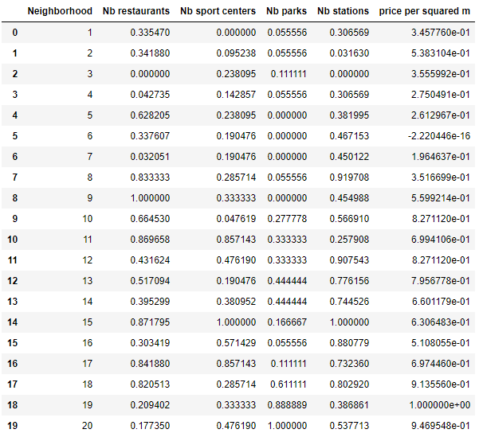
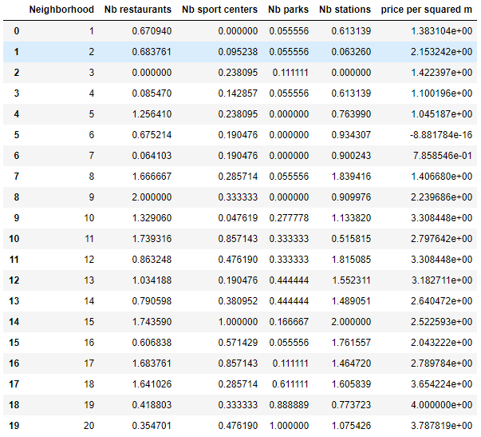
3- Used methodology
X 2
X 1
X 1
X 2
X 4
Data before and after applying the weights

Slide 9
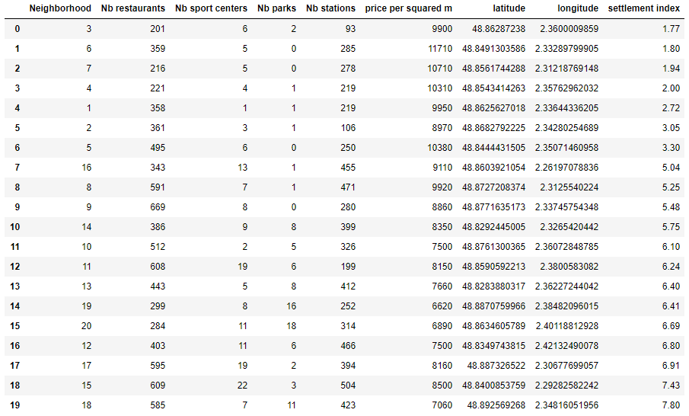
4- Results
Arrondissement = Neighborhood
Index < 4
4 < Index < 6
Index > 6
Arrondissements sorted by the settlement index
If the index < 4: bad choice, if it is > 4: acceptable choice, index > 6: excellent choice

Slide 10
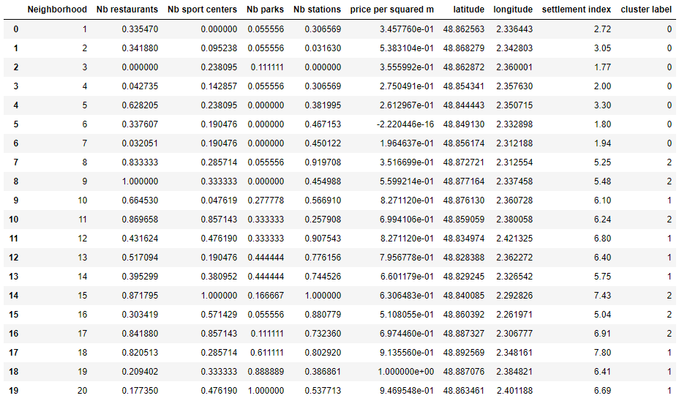
4- Results
Label = 0 corresponds very well to settlement index < 4
For label = 1 and 2, settlement index > 4
It is mainly = 5,6 and 7
An acceptable choice for a location starts from an index > 4
Results after performing clustering analysis for n = 3

Slide 11
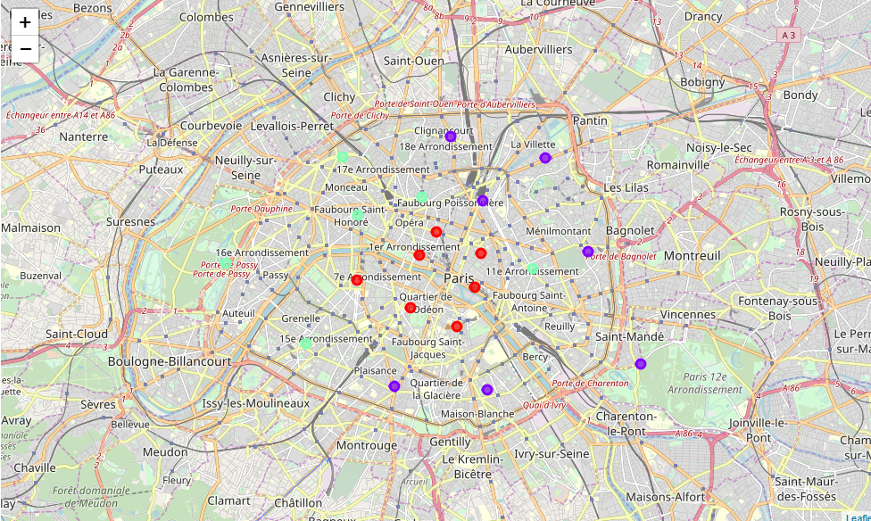
4- Results
The red circles correspond to the neighborhoods that we should avoid: It is a logic result because they are the heart of Paris and they are very expensive
The surrounding circle (sky blue + purple) correspond to the affordable ones: they respond to the company and the employees’ requirements

Slide 12
5- Conclusions
After calculating the settlement index, we were able to sort the neighborhoods, and provide a suitable choice to the company, and we were able to ensure that by performing clustering analysis
if settlement index > 6 : The company is advised to establish its new office in the corresponding neighborhoods
if settlement index is between 4 and 6 : It can be a solution
if settlement index < 4 : The company should absolutely avoid these choices
We found that : arrondissements : 1 to 7 should be avoided (< 4)
arrondissements : 16, 8, 9, 14 can be a solution ( 4< index < 6)
arrondissements : 10, 11, 13, 19, 20, 12, 17, 15, 18 are a good solution (index > 6)
As a suggestion, the company should establish the new office at the 18th arrondissement as it has the highest settlement index

